Slide 1
Eli Lilly + CO
Group 1
Notes:
Eli Lilly and Company is a leading global pharmaceutical firm headquartered in Indianapolis, Indiana. Founded in 1876, the company has built a reputation for scientific innovation and clinical excellence, particularly in areas such as diabetes, oncology, immunology, and—more recently—obesity. With a robust portfolio that includes high-demand treatments like Mounjaro and Zepbound, Lilly has emerged as a key player in the fast-growing GLP-1 drug market. Backed by strong financials, sustained R&D investment, and a track record of strategic execution, Eli Lilly is positioned at the forefront of the pharmaceutical industry in 2025.

Slide 2
Pharmaceutical Industry Overview
Strengths
Strong historical performance
High barriers to entry
Exploding demand for obesity drugs
Weaknesses
R&D costs are high and uncertain
High dependency on patent exclusivity
Opportunities
M&A environment improvement
New GLP-1 innovations
Threats
Tariff uncertainty
increased competition in GLP-1 market from Pfizer
Notes:
Strengths:
Even amid inflation, market selloffs, and regulatory chatter, the pharmaceutical industry (e.g., the XPH ETF) has outperformed major indices like the S&P 500
Drug development requires years of clinical trials, heavy regulatory approval, and billions in R&D deterring new entrants and protecting existing players.
New treatments like GLP-1 receptor agonists (e.g., Ozempic, Mounjaro) have exploded in popularity due to their effectiveness, representing a fast-growing, multi-billion dollar market.
Weaknesses:
The average cost of developing a successful drug exceeds $2 billion, with a high chance of failure. Many R&D efforts never yield commercially viable products.
Many top-selling drugs will lose patent protection in 2025, exposing companies to cheaper generic and biosimilar competition, which could result in billions in lost revenue.
Opportunities:
After a quiet 2024, companies are expected to increase mergers and acquisitions to replace lost revenue from expiring patents or enter new therapeutic areas.
The success of current GLP-1 drugs is just the beginning—future innovations might include combo drugs or expanded indications (e.g., heart disease, Alzheimer’s).
Threats:
Many pharmaceutical ingredients come from overseas (India, China). New tariffs could increase production costs and disrupt supply chains.
Though Lilly and Novo Nordisk are market leaders now, major firms like Pfizer and AstraZeneca are racing to release their own GLP-1 drugs between 2027–2030.

Slide 3
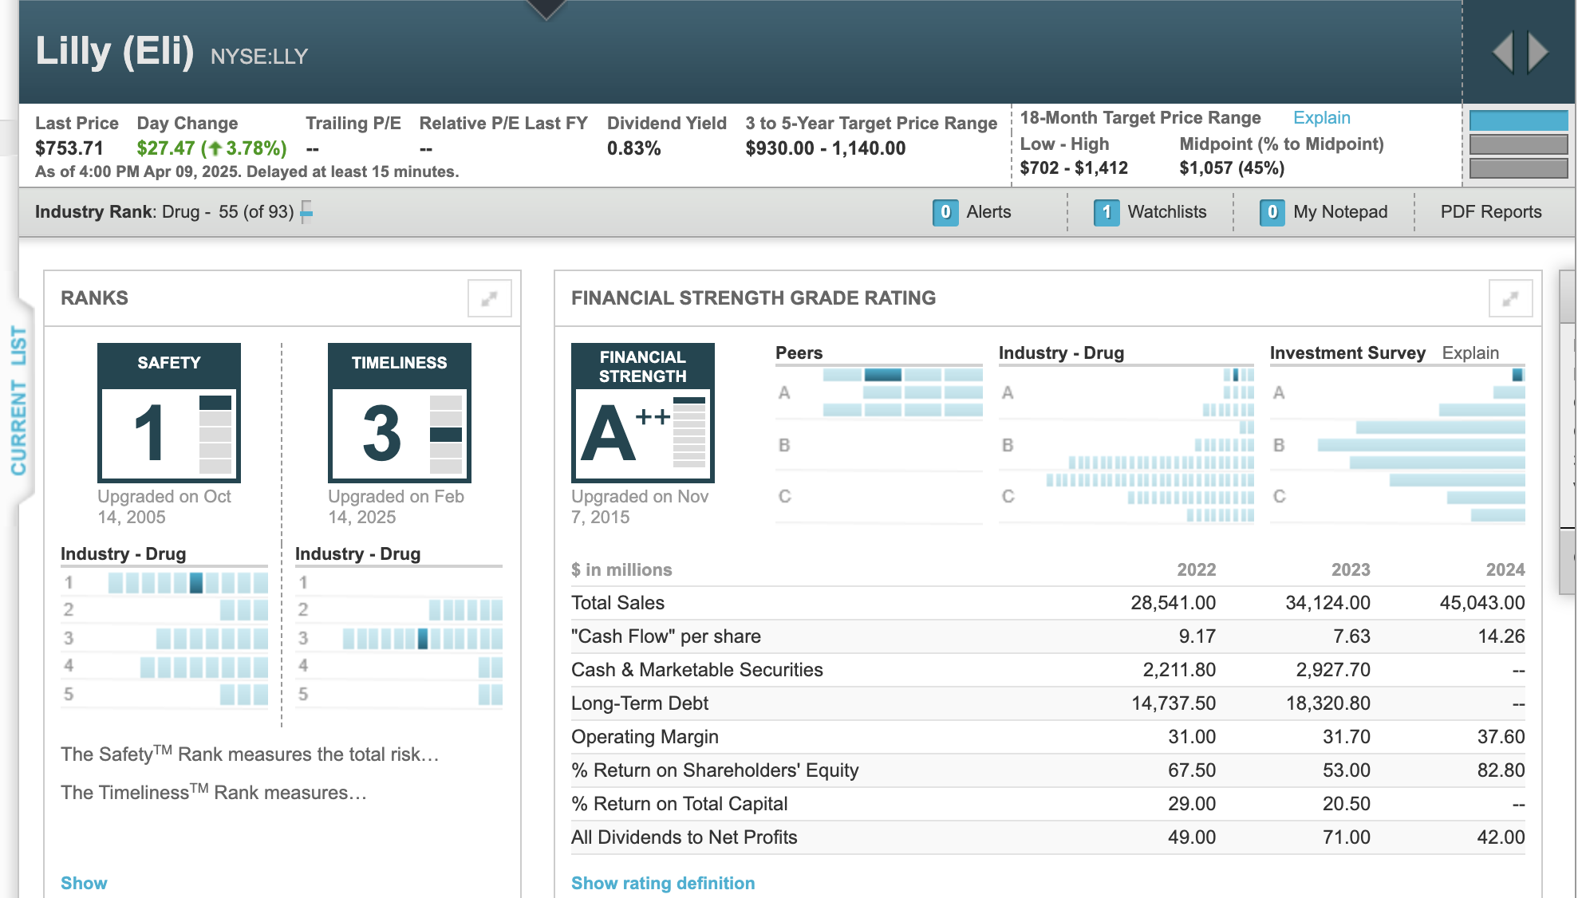
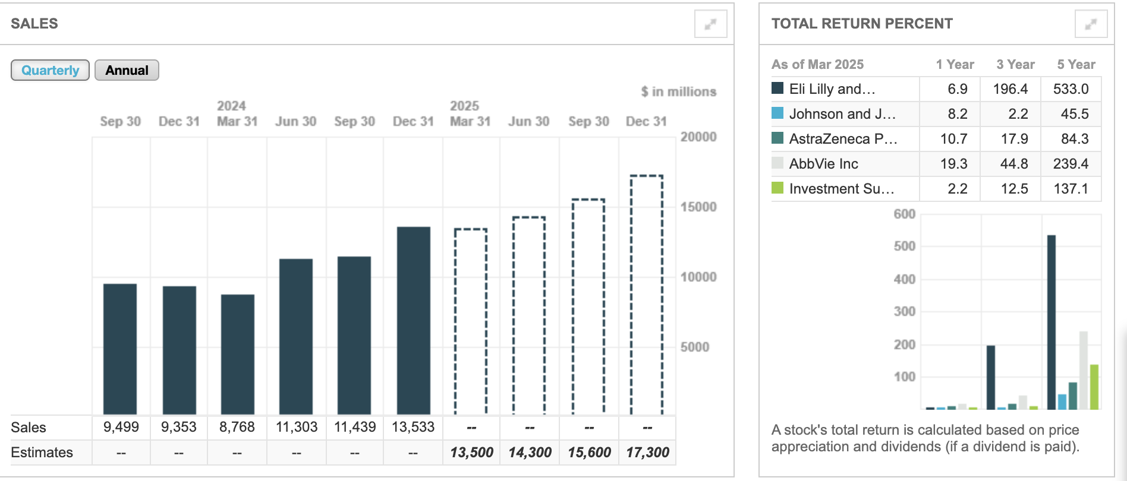
Key Metrics at a Glance
Drug Industry Rank: 55 out of 93
Eli Lilly & CO
Financial Strength Rating: A++ (Since 2015)
Operating Margin: 37.6% (impressive profitability)
Return on Equity: 82.8% (extremely high)
Total Sales: $45.04 billion
Growth Trajectory: $9.5B Q3 2023 -> $13.5B Q4 2024
Notes:
This slide summarizes some of the most important financial and operational indicators for Eli Lilly & Co, alongside its position in the broader pharmaceutical landscape.
Looking at Eli Lilly specifically, the company stands out for its exceptional financial strength. It holds an A++ rating, which is the highest possible grade, and it’s maintained this level of strength since 2015.
Lilly also demonstrates outstanding profitability, with an operating margin of 37.6%, which means that nearly 38 cents of every dollar in revenue is converted into operating profit. That’s well above the industry average.
Even more impressive is the return on equity—at 82.8%, Eli Lilly is generating enormous value relative to shareholder investment. This number is extremely high and reflects the firm’s ability to reinvest profits efficiently.
We’re seeing that strength reflected in sales growth. If you look at the bar chart on the left, you’ll notice a steady increase in quarterly sales—from $9.5 billion in Q3 of 2023 to an estimated $13.5 billion in Q4 of 2024. That’s a substantial growth trajectory in just over a year.
Overall, these metrics confirm that Eli Lilly is not only financially strong but also strategically positioned for continued growth, especially with its leadership in the obesity and diabetes treatment space.

Slide 4
Firm Overview
Strengths | Weaknesses | Opportunities | Threats
Market Leader in weight-loss drugs | Dividend yield low vs peers 0.83% | Expansion into adjacent indications | Entry of GLP-1 Therapies could erode market share
A++ strength rating 82.8% ROE | 37.6 % operating margin | Recent downgrades in price stability and earnings predictions | Forecasted sales growth to $71B by 2026 | Global supply chain due to tariffs
533% total return over 5 years |  | 3-5 year price target: $930 30-55% upside | Stock trading near upper valuation bonds
Notes:
Strengths
Eli Lilly is incredibly well-positioned in the pharmaceutical landscape, and one of its biggest strengths is its market leadership in GLP-1 drugs—specifically Mounjaro and Zepbound. These medications are central players in the booming obesity and diabetes treatment market, which is expected to exceed $100 billion globally.
Financially, the company is exceptionally strong. It holds an A++ financial strength rating, boasts an operating margin of 37.6%, and delivers a return on equity of 82.8%, which is remarkably high even within its peer group. These metrics reflect outstanding operational efficiency and investor value creation.
And from a shareholder perspective, Eli Lilly has been a star performer—its stock has returned over 530% in the past five years, far outpacing its competitors.
Weaknesses
Despite its strengths, there are a few areas of concern. Lilly’s dividend yield sits at just 0.83%, which is lower than many of its peers. This may not appeal to income-focused investors.
We’ve also seen recent insider selling activity, particularly from Lilly Endowment in March. While not necessarily negative on its own, it may raise questions around insider sentiment.
Finally, Lilly recently received slight downgrades in price stability and earnings predictability scores, indicating that analysts are watching for potential volatility or deviations from expected performance.
Opportunities
Looking ahead, the opportunities are substantial. Sales are projected to grow to $71 billion by 2026, driven by expanding demand for its GLP-1 portfolio and potential expansion into adjacent therapeutic areas, such as cardiovascular health.
The company is also well-positioned to benefit from continued innovation, including next-gen obesity treatments, combination therapies, and broader global distribution.
Analysts forecast a 30% to 55% price appreciation over the next 3 to 5 years, suggesting confidence in both its financials and strategic direction.
Threats
But with high performance comes high expectations. Eli Lilly’s current valuation already reflects significant optimism—so any pipeline delays or market shifts could weigh heavily on the stock.
There’s also rising competition in the GLP-1 space, with major players like Pfizer and AstraZeneca expected to launch competing products by the end of the decade.
Lastly, regulatory pressure—especially around drug pricing—and potential global supply chain disruption due to tariffs could present challenges moving forward.

Slide 5
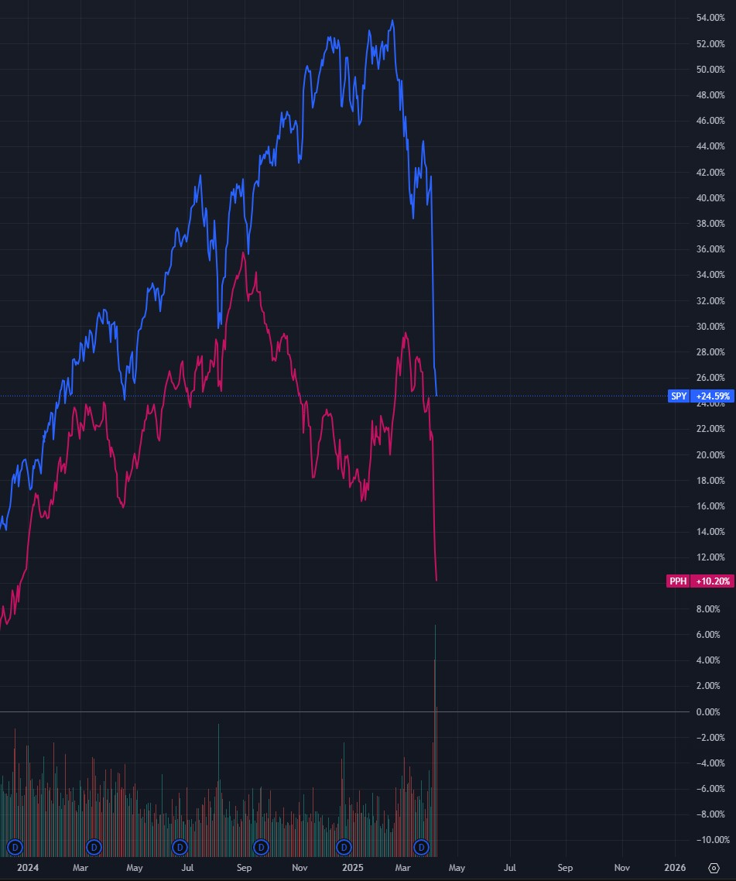
SPY vs PPH Daily Chart
S&P 500 (SPY)
Experienced growth for most of the year and peaked at +54%
underwent significant volatility and a sharp decline towards the end of the period
Currently stands at +24.59%, year-over-year, reflecting a considerable correction from its peak
Pharmaceutical Industry (PPH)
Initially showed positive returns but consistently underperformed the S&P 500
Peaked at around +36% during the period but faced a similar notable decline as the S&P 500
Currently stands at +10.20% year-over-year, reflecting its underperformance relative to the S&P 500
Analysis:
The pharmaceutical industry generally tracked the direction of the S&P 500 throughout much of the period. However significant divergence emerged in late 2024 and early 2025. While both SPY and PPH experienced downturns, PPH’s decline was substantially steeper, which reflects industry specific challenges.

Slide 6
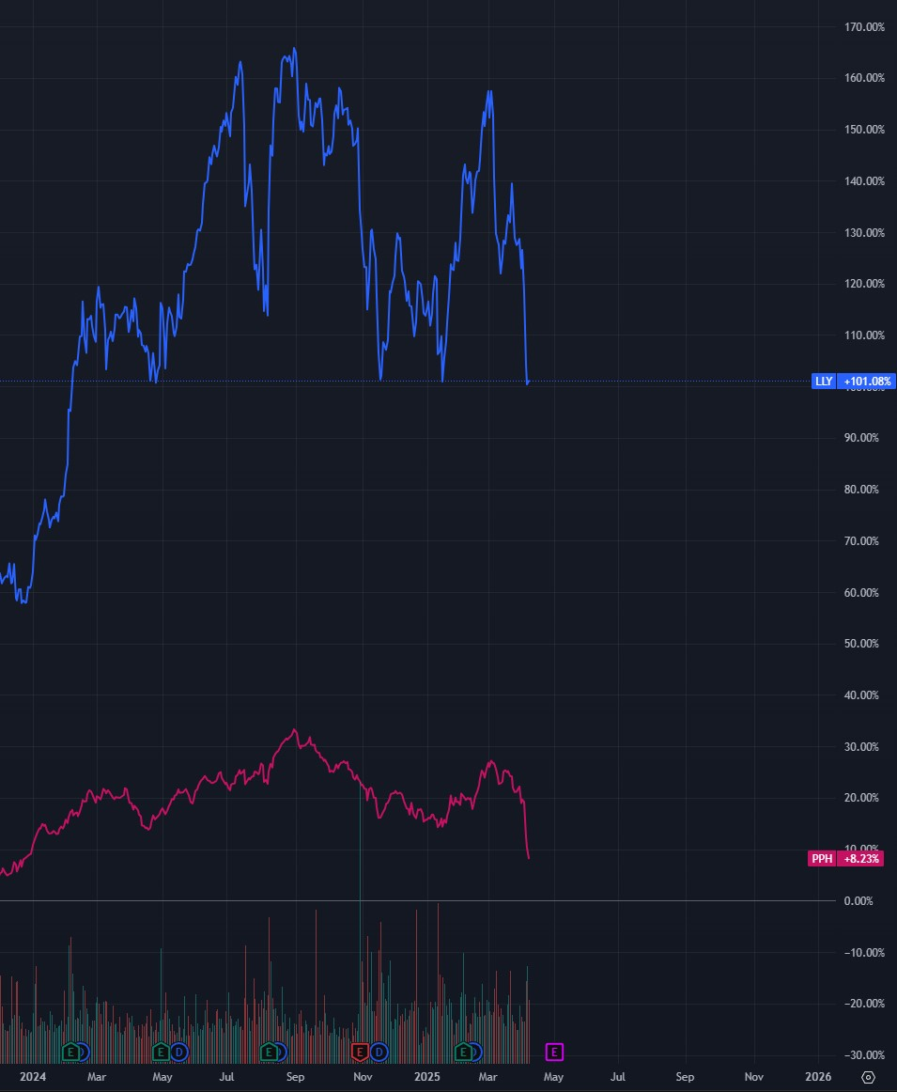
LLY vs PPH Daily Chart
Eli Lilly (LLY)
Experienced significant growth throughout the past 12 months and outperformed the broader pharmaceutical industry
Peaked at +165% year-over-year, reflecting strong investor optimism
Underwent significant volatility in recent months
Currently stands at +101.8%, year-over-year, reflecting exceptional performance relative to industry comparables
Pharmaceutical Industry (PPH)
Exhibited growth early on but substantially underperformed LLY throughout the entire period
Peaked at around +35% but experienced a significant decline in late 2024 and early 2025
Current stands at +8.23%, year-over-year, significantly lower than LLY
Analysis:
Eli Lilly consistently outperformed the pharmaceutical industry, highlighting strong company performance. A pronounced divergence emerged from the beginning of the period and was maintained throughout, suggesting a sustained investor confidence specifically towards Eli Lilly. Despite recent market volatility affecting both LLY and PPH, LLY maintained significantly higher returns, reflecting its notable performance within the pharmaceutical sector.

Slide 7
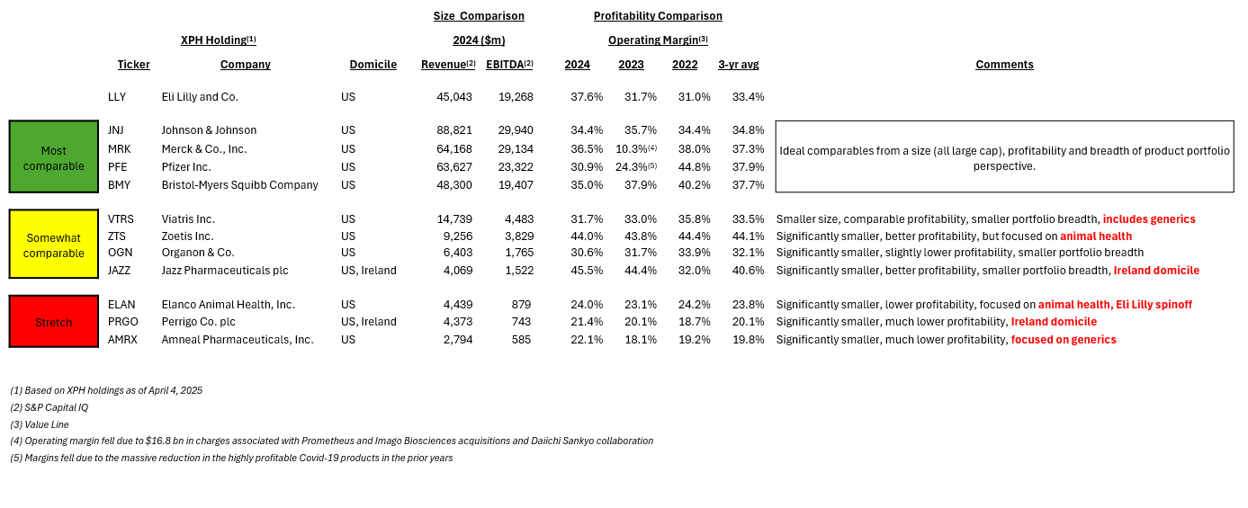
Comparable Companies Selection
Notes:
1. XPH included other companies that were too far from Eli Lilly from the perspective of size, profitability, and business model comparability
2. XPH does not include several foreign pharma companies with US ADRs like GSK, Novartis, Sanofi, and Roche. It also does not include AbbVie.

Slide 8
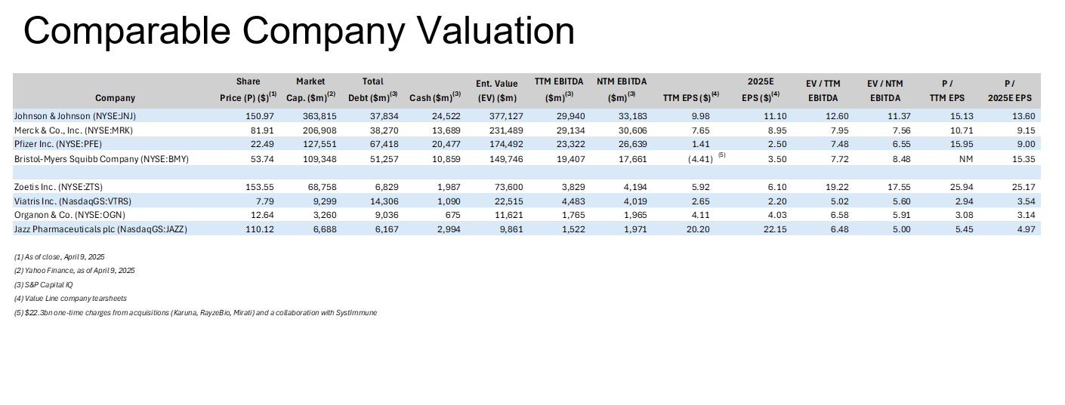
Comparable Company Valuations
Notes:
1. JNJ's high multiple is attributable to its diversified businesses (pharma, medtech, and consumer health), consistent earnings growth, and strong balance sheet
2. Zoetis's high multiple is underpinned by its market leadership in animal health, consistent growth, and premium profitability
3. While some of the smaller companies may have comparable profitability as the larger ones, their multiples are lower due to higher leverage and smaller breadth

Slide 9
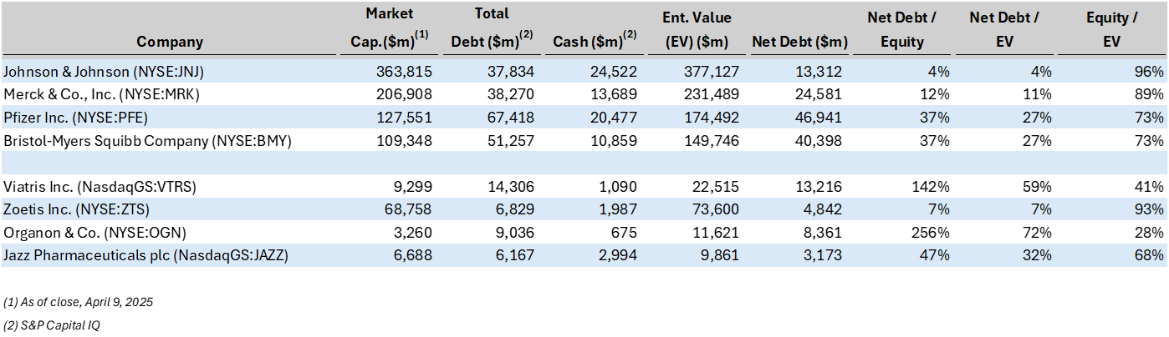
Capital Structure
Notes:
1. JNJ and Zoetis have very little leverage
2. Viatris and Organon have comparatively the highest leverage

Slide 10
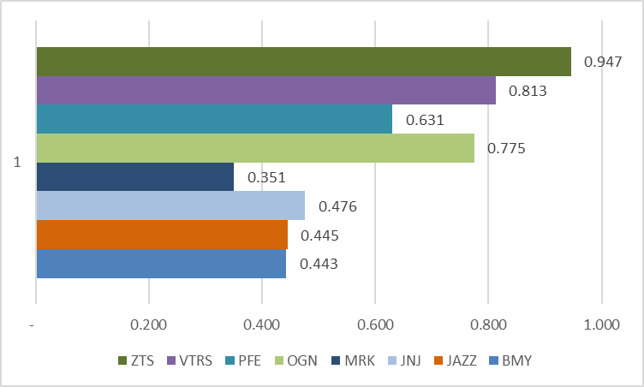
Betas

Slide 11
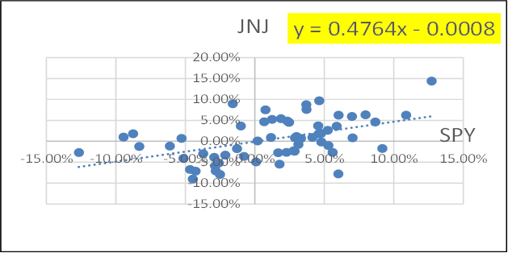
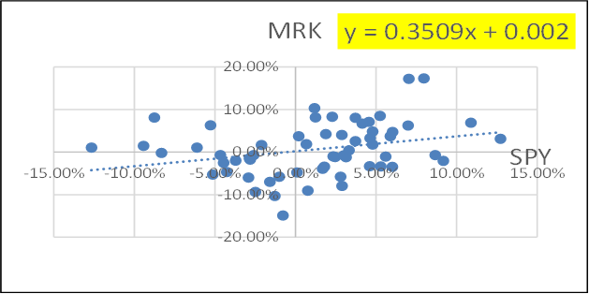
Beta Graphs (1)

Slide 12
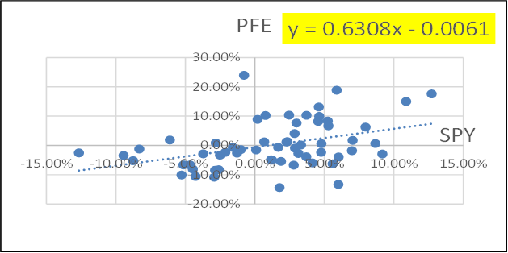
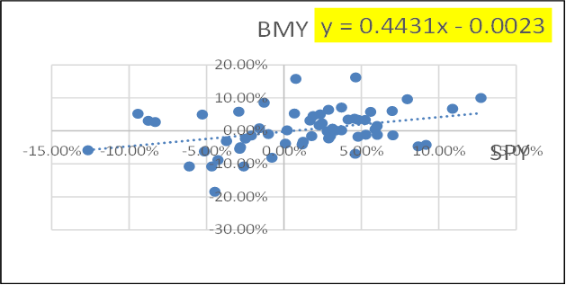
Beta Graphs (2)

Slide 13
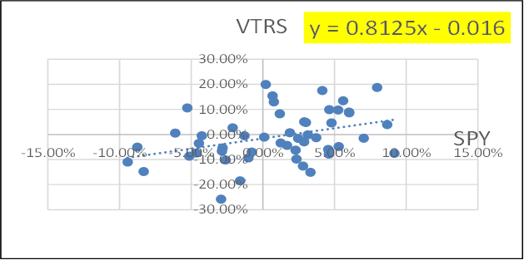
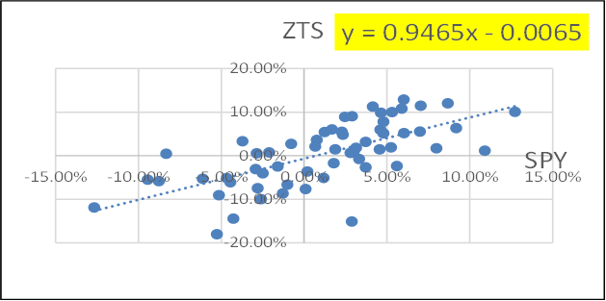
Beta Graphs (3)

Slide 14
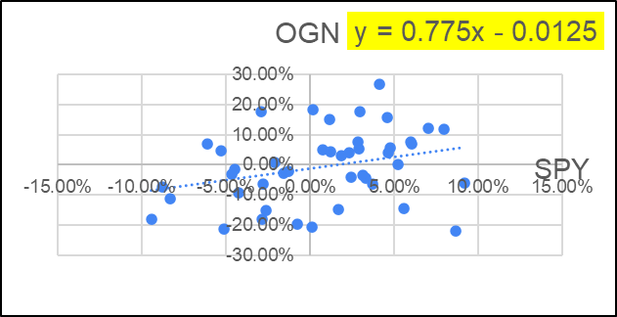
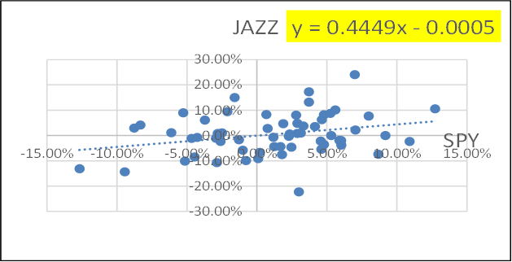
Beta Graphs (4)

